Slide 1


Slide 2


Slide 3
+Y
x0, y1
x1, y1
3
2
float x0 = -0.5f;
float y0 = -0.5f;
float x1 = 0.5f;
float y1 = 0.5f;
0
1
+X
x0, y0
x1, y0
x0, y0
x1, y0
x1, y1
x0, y1

Slide 4
EIXO Z

Slide 5



Slide 6
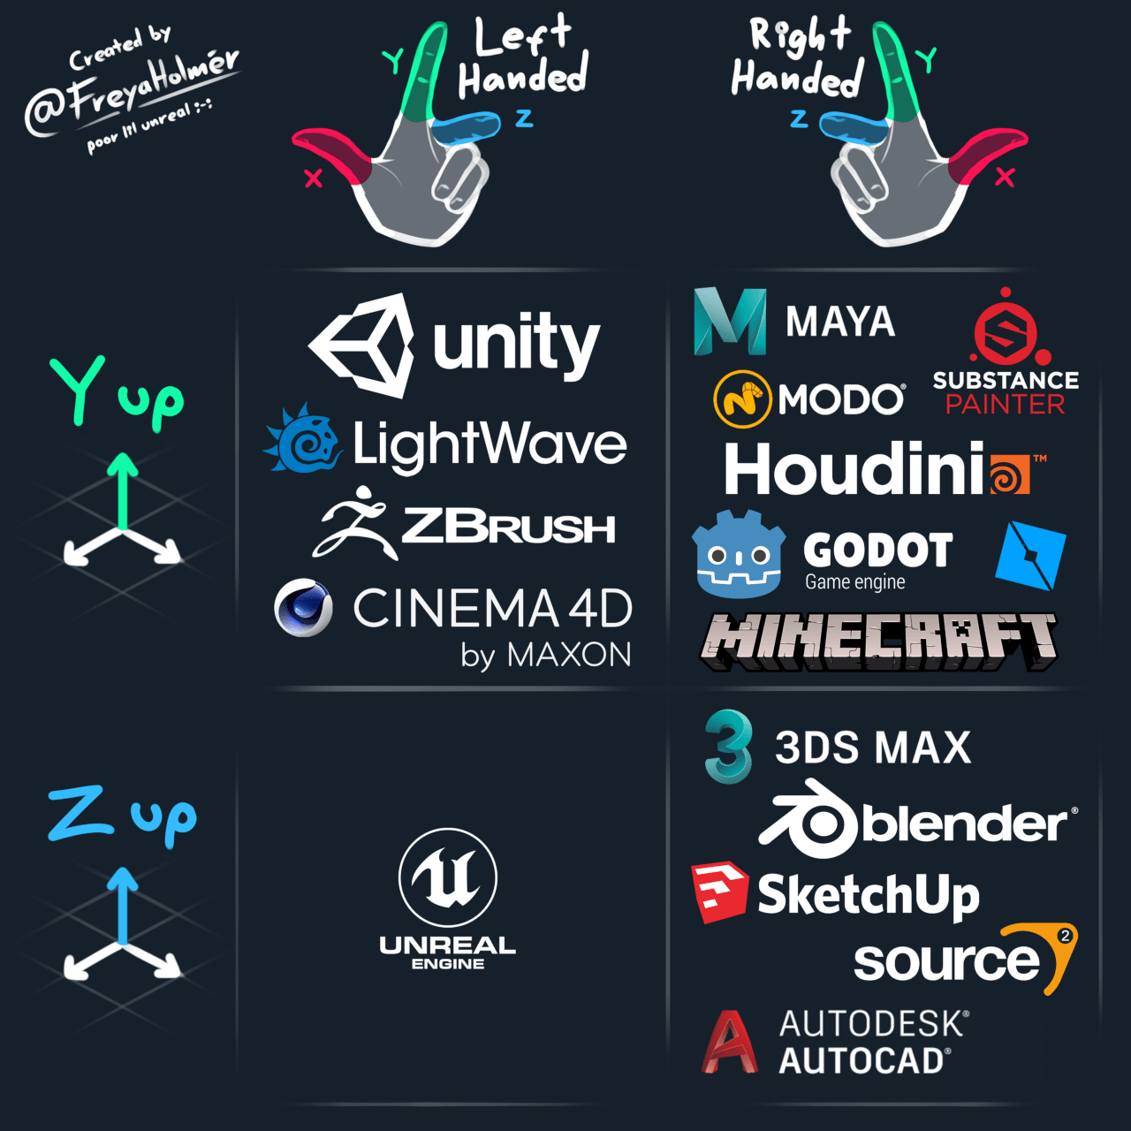

Slide 7

+Y
+Z
+X

Slide 8

+Z
+?
+?

Slide 9

+Z
+?
+?

Slide 10

+Y
+X
+Z

Slide 12
+Y
x1, y1
x0, y1
2
3
float x0 = -0.5f;
float y0 = -0.5f;
float x1 = 0.5f;
float y1 = 0.5f;
+X
1
x0, y0
x1, y0
x1, y1
x0, y1
0
x1, y0
x0, y0

Slide 13
+Y
x1, y1
x0, y1
2
3
float x0 = -0.5f;
float y0 = -0.5f;
float x1 = 0.5f;
float y1 = 0.5f;
+X
1
x0, y0
x1, y0
x1, y1
x0, y1
0
x1, y0
x0, y0
+Z

Slide 15
+Y
x1, y1, z0
x0, y1, z0
3
2
x1, y1, z1
x0, y1, z1
2
3
float x0 = -0.5f;
float y0 = -0.5f;
float z0 = -0.5f;
float x1 = 0.5f;
float y1 = 0.5f;
float z1 = 0.5f;
0
1
x1, y0, z0
+X
x0, y0, z0
1
x1, y0, z0
x0, y0, z0
x0, y1, z0
x1, y1, z0
0
x1, y0, z1
x0, y0, z1
+Z

Slide 16
private float[] vertexBuffer = new float[300000];
private int[] triangleBuffer = new int[600000];
private float[] texCoordBuffer = new float[200000];
private int vertices = 0;
private float u;
private float v;
private bool hasTexture = false;

Slide 17
private flush() {
[...]
GL.GenBuffers(1, out this.VBO);
GL.BindBuffer(BufferTarget.ArrayBuffer, this.VBO);
GL.BufferData(BufferTarget.ArrayBuffer, this.vertexBuffer.Length * sizeof(float), this.vertexBuffer, BufferUsageHint.StaticDraw);
GL.VertexAttribPointer(0, 3, VertexAttribPointerType.Float, false, 0, 0);
GL.EnableVertexAttribArray(0);
[...]
}

Slide 18
private void vertex(float x, float y, float z) {
vertexBuffer[this.vertices * 3 + 0] = x;
vertexBuffer[this.vertices * 3 + 1] = y;
vertexBuffer[this.vertices * 3 + 2] = z;
if(this.hasTexture) {
this.texCoordBuffer[this.vertices * 2 + 0] = this.u;
this.texCoordBuffer[this.vertices * 2 + 1] = this.v;
}
this.vertices++;
if(this.vertices % 4 == 0) {
int _vertex = this.vertices - 4;
// primeiro Triângulo
this.triangleBuffer[_vertex * 6 + 0] = 0 + _vertex;
this.triangleBuffer[_vertex * 6 + 1] = 1 + _vertex;
this.triangleBuffer[_vertex * 6 + 2] = 2 + _vertex;
// segundo Triângulo
this.triangleBuffer[_vertex * 6 + 3] = 0 + _vertex;
this.triangleBuffer[_vertex * 6 + 4] = 2 + _vertex;
this.triangleBuffer[_vertex * 6 + 5] = 3 + _vertex;
}
}
private void tex(float u, float v) {
this.hasTexture = true;
this.u = u;
this.v = v;
}

Slide 19
+Y
x1, y1, z1
x0, y1, z1
2
3
float x0 = -0.5f;
float y0 = -0.5f;
float z0 = -0.5f;
float x1 = 0.5f;
float y1 = 0.5f;
float z1 = 0.5f;
+X
1
x0, y0, z1
x1, y0, z1
x1, y1, z1
x0, y1, z1
0
x1, y0, z1
x0, y0, z1
+Z

Slide 20
+Y
x1, y1, z0
x0, y1, z0
3
2
float x0 = -0.5f;
float y0 = -0.5f;
float z0 = -0.5f;
float x1 = 0.5f;
float y1 = 0.5f;
float z1 = 0.5f;
0
1
x1, y0, z0
+X
x0, y0, z0
x1, y0, z0
x0, y0, z0
x0, y1, z0
x1, y1, z0
+Z

Slide 21
private void matrixView() {
Matrix4 view = Matrix4.Identity;
view *= Matrix4.CreateFromAxisAngle(new Vector3(0.5f, 1.0f, -3.0f), (float)GLFW.GetTime());
view *= Matrix4.CreateTranslation(new Vector3(0.0f, 0.0f, -10.0f));
this.shader.setMatrix4("view", view);
}

Slide 22
+Y
x1, y1, z0
x0, y1, z0
2
3
x1, y1, z1
x0, y1, z1
1
0
float x0 = -0.5f;
float y0 = -0.5f;
float z0 = -0.5f;
float x1 = 0.5f;
float y1 = 0.5f;
float z1 = 0.5f;
+X
x0, y1, z1
x1, y1, z1
x1, y1, z0
x0, y1, z0
+Z

Slide 23

+Y
float x0 = -0.5f;
float y0 = -0.5f;
float z0 = -0.5f;
float x1 = 0.5f;
float y1 = 0.5f;
float z1 = 0.5f;
1
0
x1, y0, z0
+X
x0, y0, z0
2
x0, y0, z0
x1, y0, z0
x1, y0, z1
x0, y0, z1
3
x1, y0, z1
x0, y0, z1
+Z

Slide 24
+Y
x1, y1, z0
2
x1, y1, z1
3
float x0 = -0.5f;
float y0 = -0.5f;
float z0 = -0.5f;
float x1 = 0.5f;
float y1 = 0.5f;
float z1 = 0.5f;
1
x1, y0, z0
+X
0
x1, y0, z1
x1, y0, z0
x1, y1, z0
x1, y1, z1
x1, y0, z1
+Z

Slide 25
+Y
x0, y1, z0
3
x0, y1, z1
2
float x0 = -0.5f;
float y0 = -0.5f;
float z0 = -0.5f;
float x1 = 0.5f;
float y1 = 0.5f;
float z1 = 0.5f;
0
+X
x0, y0, z0
x0, y0, z0
x0, y0, z1
x0, y1, z1
x0, y1, z0
1
x0, y0, z1
+Z

Slide 28
2
3
1
0
0, 1, 2
0, 2, 3

Slide 29
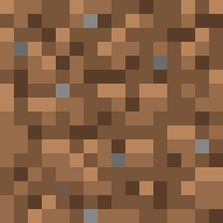
7
6
4
5
4, 5, 6
4, 6, 7

Slide 30
10
11
9
8
8, 9, 10
8, 10, 11

Slide 31
13
12
14
15
12, 13, 14
12, 14, 15

Slide 32
18
19
17
16
16, 17, 18
16, 18, 19

Slide 33
23
22
20
21
20, 21, 22
20, 22, 23

Slide 35
private void matrixView() {
Matrix4 view = Matrix4.Identity;
//view *= Matrix4.CreateFromAxisAngle(new Vector3(0.5f, 1.0f, -3.0f), (float)GLFW.GetTime());
view *= this.LookAt();
view *= Matrix4.CreateTranslation(new Vector3(0.0f, 0.0f, -10.0f));
this.shader.setMatrix4("view", view);
}
Private Matrix4 LookAt() {
// Configura a matriz de visualização isométrica
Vector3 eye = new Vector3(1.0f, 1.0f, 1.0f); // Posição da câmera
Vector3 target = Vector3.Zero; // Onde a câmera está olhando
Vector3 up = Vector3.UnitY; // Direção "para cima" da câmera
return Matrix4.LookAt(eye, target, up);
}

Slide 36
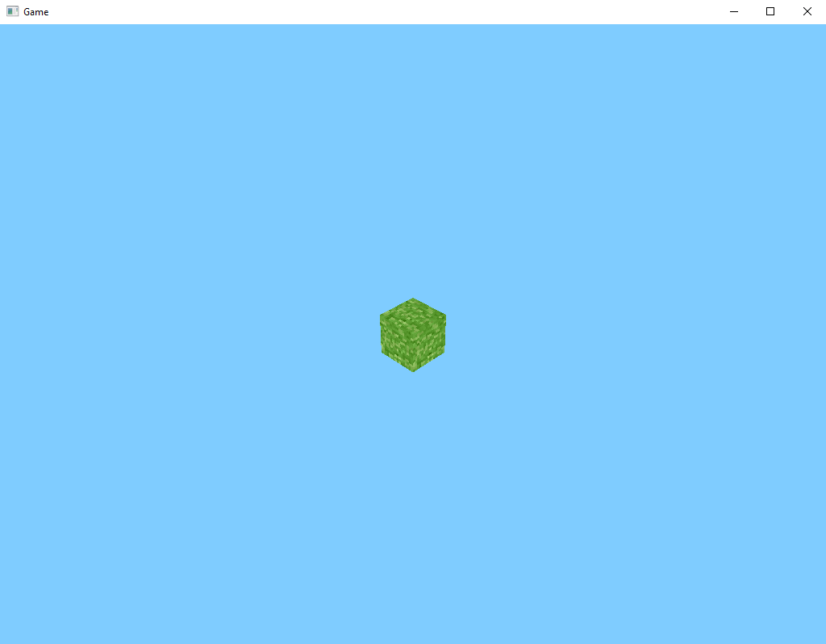

Slide 37
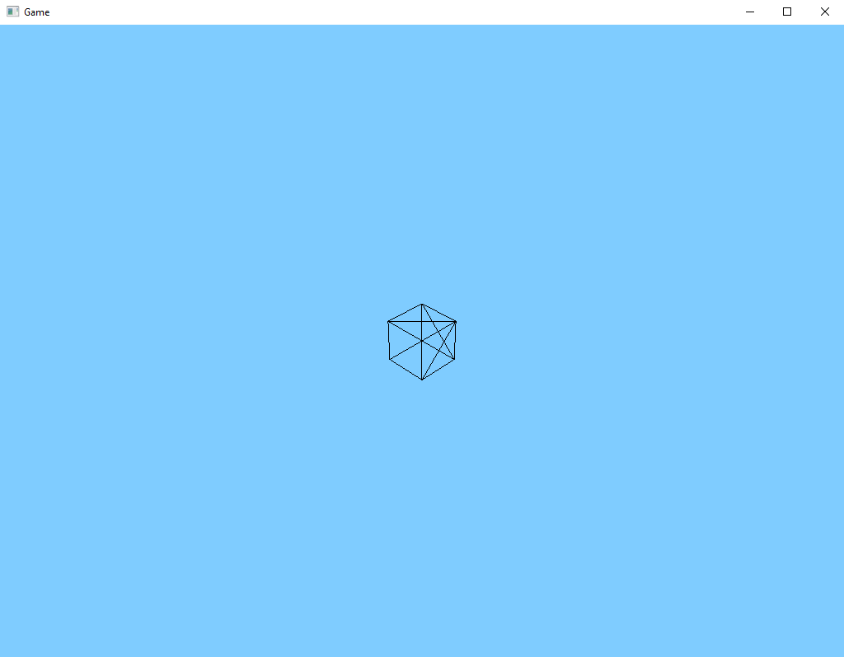

Slide 38
private void openGL_settings() {
GL.Enable(EnableCap.DepthTest);
GL.Enable(EnableCap.CullFace);
GL.CullFace(CullFaceMode.Back);
}

Slide 39
